Slide 1


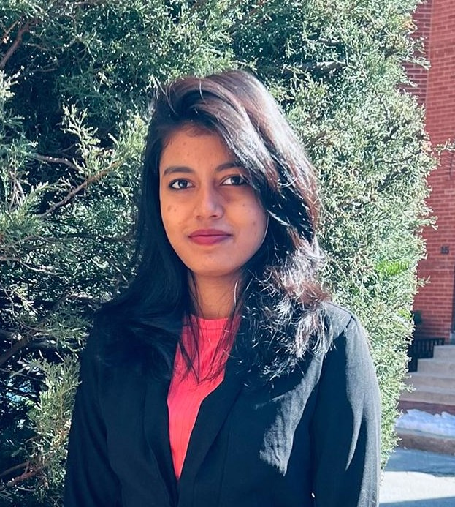


Nikola chairman Trevor Milton resigns
Group 7 :
Jiajia Liu (001568540) Kang Shentu (001569432) Sowmika Adepu (002922551) Pranav Shailesh Adhav (001519666) Pavithra Ramkumar (002929680)

Slide 2
Background: Trevor Milton’s Previous Work
2010
Trevor Milton Strated company dHybrid later it was purchased by Worthington Industries.
2020
Trevor Milton presented the idea of making long haul semi trucks which will powered by hydrogen and electricity
2020
General Motors was took a $2 billion stake in the Nikola company
2014
Trevor Milton founded Nikola with a plan to produce zero-emission semi trucks

Slide 3
Main Issue
In 20 sept 2020 , Nikola announced that trevor melton had resigned as chairman he is surrounded by the allegations that he had deceived investors about the company’s technology.
Trevor milton said that accusations by Hindenburg “false and defamatory” and said they would complain to the Securities and Exchange Commission.
Nikola shares fell sharply after the Hindenburg report. They lost 19 percent shares in a day.

Slide 4
What is Interesting about this Case
Nikola's stock price skyrocketed after its Nasdaq debut in June but has traded sharply lower since short-seller Hindenburg, which says it holds no position in the firm, published a report last September calling the electric vehicle company an “intricate fraud”
Resigned after an investment fund accused him of making false assertions about his company's technology.

Slide 5
Ethical Significance
Nikola shouldn't have given false affirmations and misleading statements to investors about the electric and hydrogen-powered truck startup saying that he would move the company’s location to Nevada or Texas if his demands are not met.
No matter how big or reputed the company is, Nikola should consider and respect the investers.especially when it involves Investments.
Ethical note: If Nikola doesn’t inherently have any technology of note, it is unethical to set up partnerships with companies that have the technology and are trying to pull it all together.

Slide 6
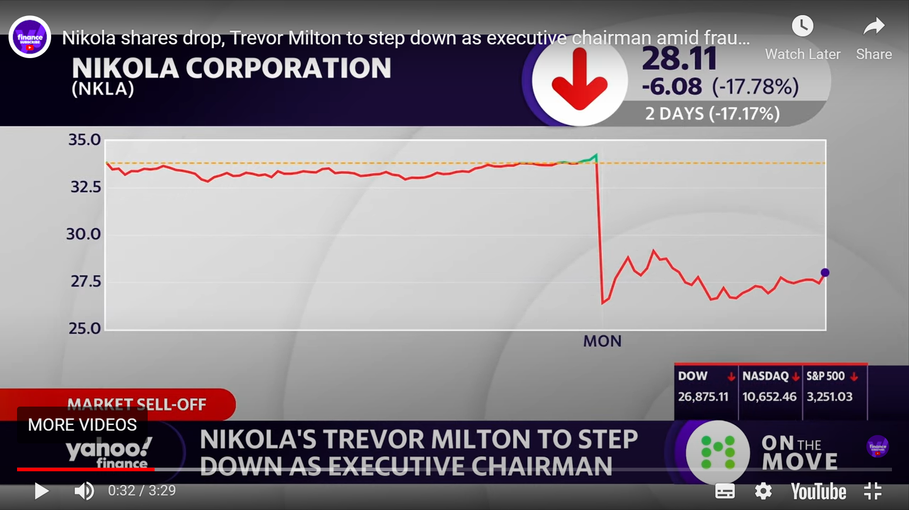
Impact – Public/Personal
General Motors cancelled their stake with Nicola who was the key partner for supply in development of electric vehicle company. This deal would have given GM an 11% stake in Nikola.
Nicola corporation paid $125 Million to settle SEC fraud allegations and shares were dropped by 18% as Trevor Milton Resigned.
Employees of Nicola Corporation like CLO, CFO assaulted Trevor Character to proctect the company
Visionary struggling with execution
desire to Lead a billionaire Lifestyle
Trading stock for Assets
Preoccupation with social
Desire for Control & difficulty tolerating challengers
Manic Behavior

Slide 7
Consequences
For Market
For Nikola Company
Former General Motors vice Chairman and Nikola board member Stephen Girsky was named the new executive chairman.
Shares of Nikola dropped around 10% in trading on the day the report was published. Shares of Nikola fell 22% in US pre-market trading on Monday following the news of Milton's departure.
For Cooperation Company
For Trevor Milton
GM CEO Mary Barra later said the company remains confident about its deal with electric truck startup Nikola Motors
Trevor Milton says he intends to defend himself against false allegations made against him by his detractors.

Slide 8
Conclusion
Was this preventable?
Yes.
For investors
Need more conservative
For individuals
Have a mind of one’s own

Slide 9
THANK YOU

